Slide 1

Title of the Presentation
Author Name 1, Author Name 2, etc
(please underline the name of the presenting author)
Affiliation line 1
Affiliation line 2
Affiliation line 3, etc.

Slide 2
Content
General Guidelines
Template Guidelines
Standard Presentation Framework
Some Recommendations about Preparation
Some Recommendations about Delivery
Conclusions

Slide 3
General Guidelines
This suggested template is provided for LAMC 2026, though custom templates are welcome if they maintain a clear and effective format.
A legible font size between 20 pt and 24 pt is recommended. Standard clean fonts like Arial, Calibri, or Helvetica work best for readability.
All diagrams, charts, and figures should be large enough to be easily readable from the back of the room.

Slide 4
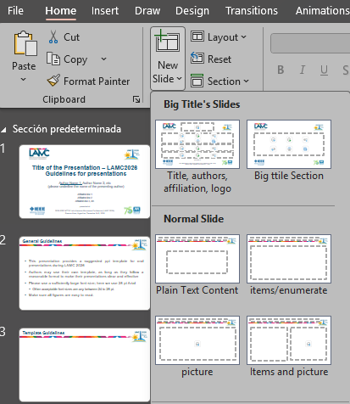
Template Guidelines
The template includes predefined slide layouts that can be selected via the New Slide menu (see Fig.1).
Alignment guides are included in the template to help maintain proper margins.
It is recommended to follow the template guidelines to ensure visual consistency.
1
2
Fig. 1: Templates for titles and content slides.

Slide 5
Standard Presentation Framework
A Standard Presentation Framework consists of:
A cover slide that includes the title, affiliations, and presenter details.
An outline slide that states the structure of the talk.
A typical content flow that encompasses the introduction, motivation, challenges, proposed solution, and conclusions.
A comparative analysis that contrasts your results with related works.
A concluding slide that summarizes the talk and reinforces the central idea.
A backup section that includes additional slides for potential questions.

Slide 6
Some Recommendations about Preparation
Plan and rehearse the presentation, ensuring the delivery feels structured yet conversational.
Do not overload a single slide. Use more slides if necessary.
Choose high contrast font colors. Use dark lines/text on a light background.
Be sure your speech is given within the allowed time.
Anticipate questions and be prepared to answer them.
Upload your presentation well ahead the beginning of the conference.

Slide 7
Some Recommendations about Delivery
Keep frequent eye contact with the audience
Do not read notes during your presentation
Moderate your speech rate
Use moderate gestures to reinforce the verbal message
Do not use sound effects
Limit your presentation to the previously allocated time

Slide 8
Backup Slides

Slide 9
Backup Slides
After your final slides, it is recommended to prepare some additional slides with figures, references, formulations, etc., to facilitate your answers to potential questions from the audience.

